Slide 1
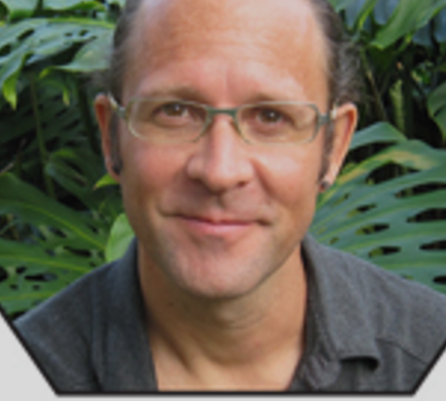
Jason Walker
By Yingchao Yu

Slide 2
Jason Walker
Location Bellingham, WA
Born 1973 Pocatello, ID
Education 1999 MFA degree, The Pennsylvania State University, State College, PA 1996 BFA degree, Utah State University, Logan, UT

Slide 3
His Divergence
Walker’s arts show the intersecting world where nature and technology meet. The combination of woodland animals with industrial elements will cause our thinking.

Slide 4
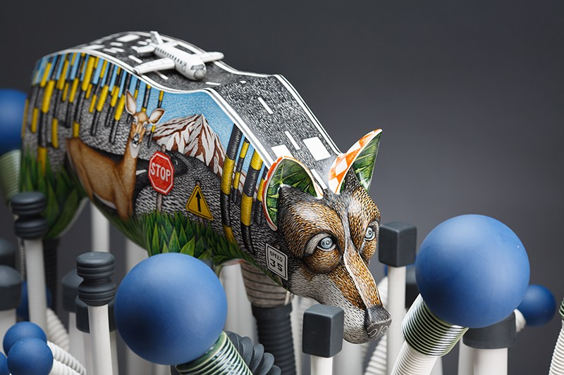
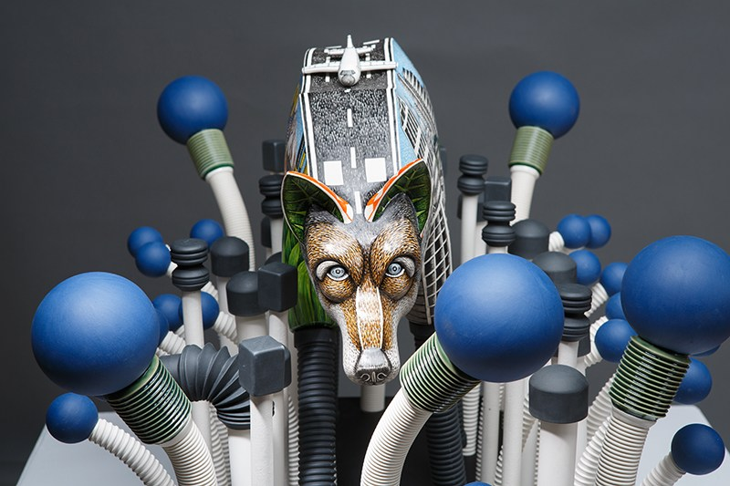
WildFlowers

Slide 5
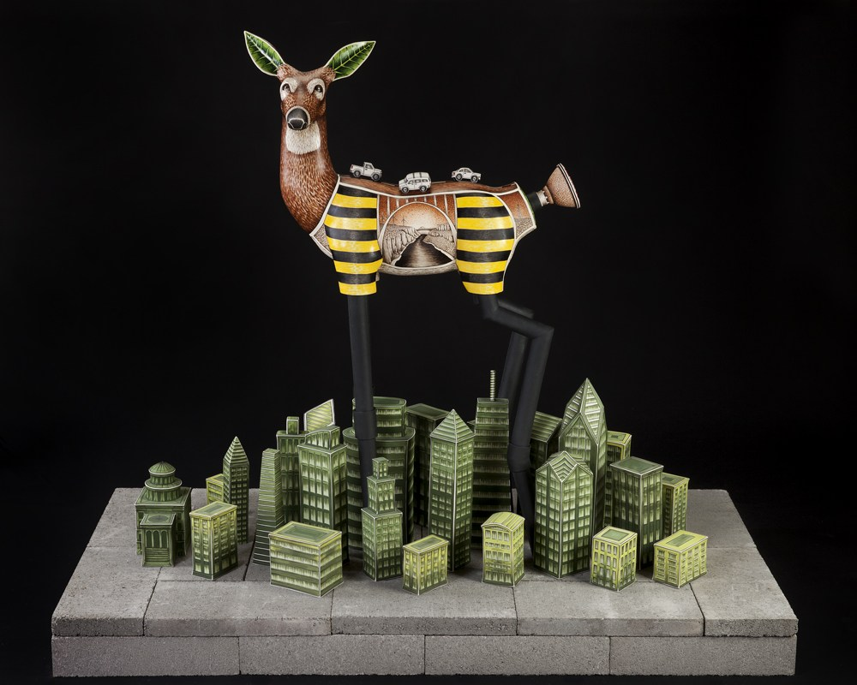
Redtail

Slide 6
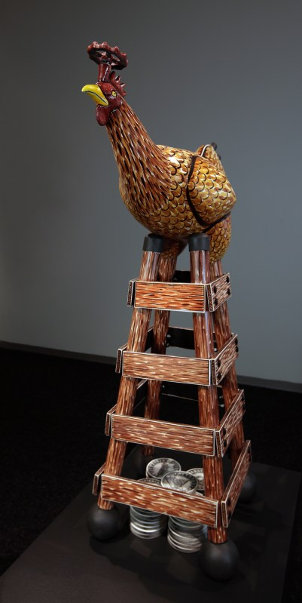
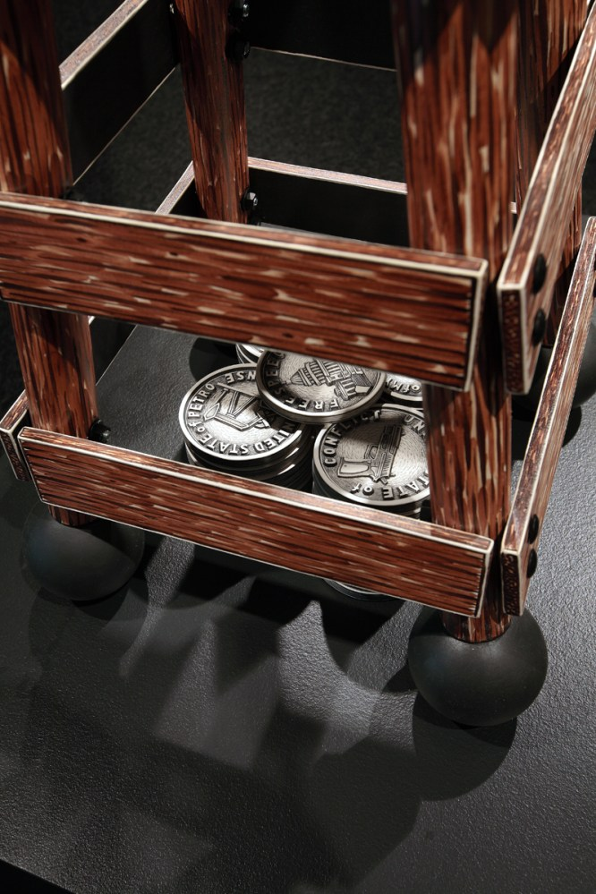
Cage Free Capitalism

Slide 7
Artist Statement
In my ceramic sculpture, I have been exploring American ideas of nature and how technology has changed our perceptions of nature. Besides the obvious advantages technology may bring to our lives, there lie unintended consequences and underlying messages behind every creation that forever change our perceptions, our social interactions and our relationship to nature.

Slide 8
Thank you!

